Slide 1

Implantable Motor Controller with Wireless Power
Kenneth Galindo, Elijah Mattheson, Johan Fausto, and Antony Barzola

Slide 2
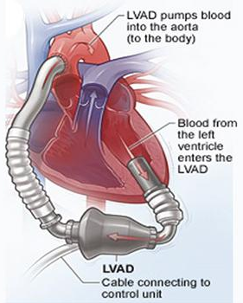
Ventricular Assist Devices
Most devices are placed in the left ventricle.
Requires complicated open-heart surgery to implant.
Can be used by patients awaiting heart transplants.
Can be used as an extended form of therapy.
Requires a power cord passing through skin to power and control the device.
[1]

Slide 3
Objective
Design a functioning motor controller that will fit within the left ventricle.
It must be at maximum 8 mm in width and a 76 mm height.
The speed of the motor must be adjustable.
Initiate the design of a wireless receiver

Slide 4
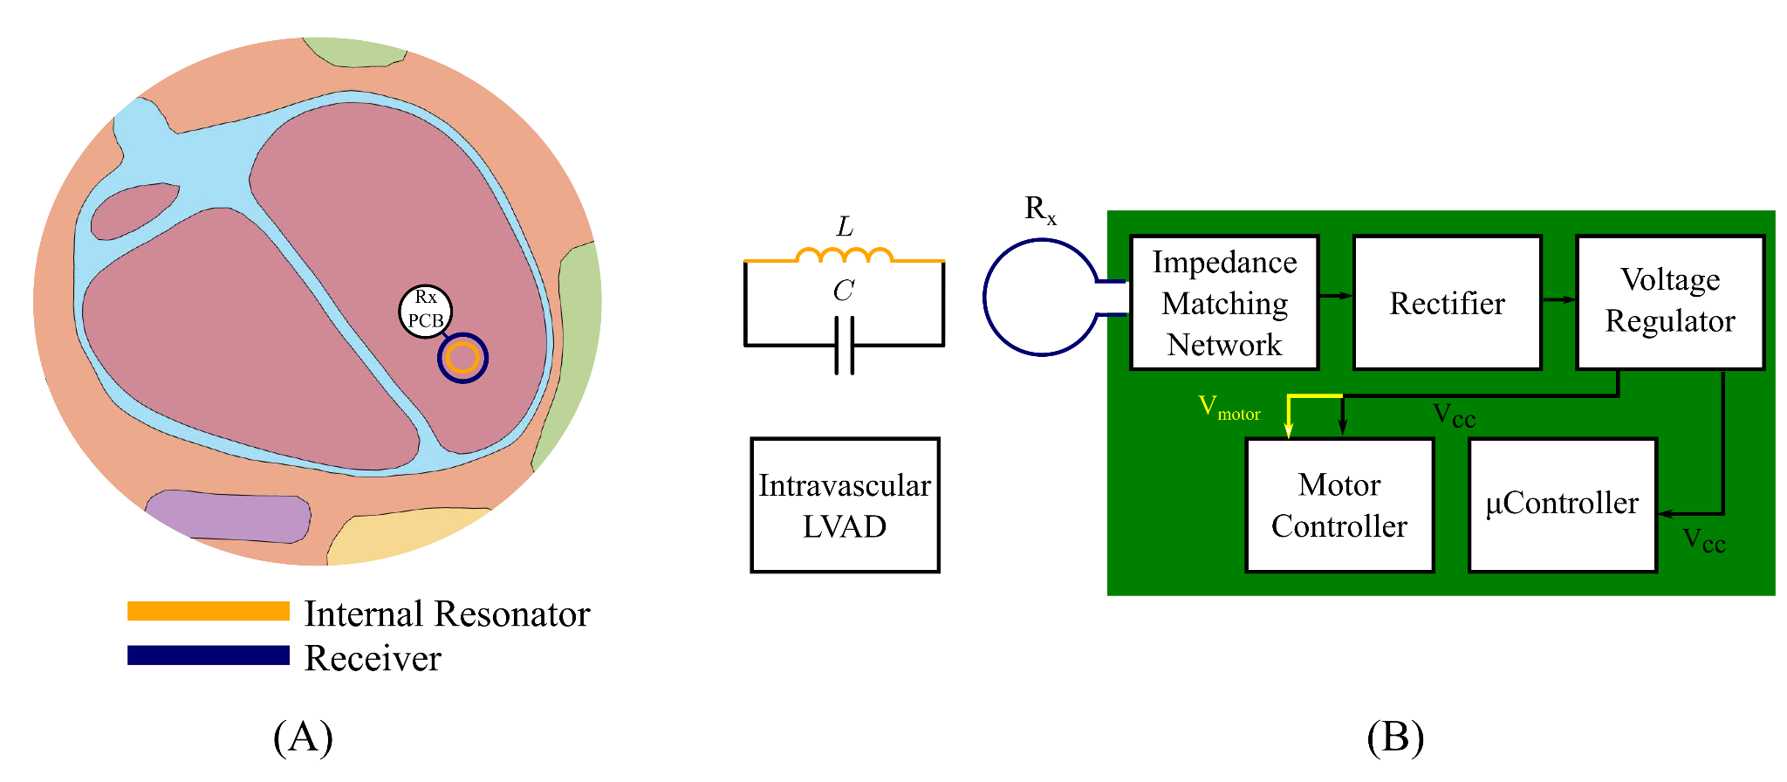

Slide 5
Motor Controller and μController
Programming of Microcontroller
Demo PCBs
Soldering
Implementation
Results

Slide 6
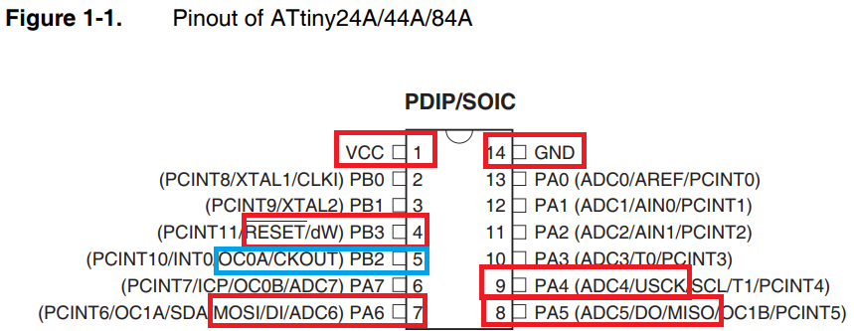
Motor Controller and μController
UART pinout of the ATTINY24A
VCC, GND, RESET, SCK, MOSI, and MISO pins were used with communication to PICKIT 4
PB2 used as output for PWM waveforms
[2]

Slide 7
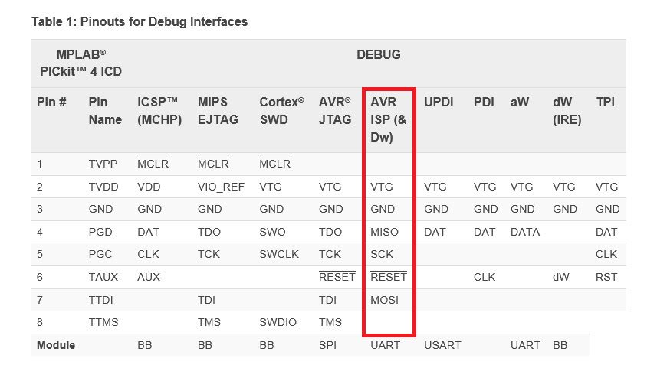
Motor Controller and μController
In order to communicate with ATTINY24A, UART module from PICkit 4 was used
Pins 2-7 were utilized in order to establish successful connection between TINY24 microcontroller and PICKit
[3]

Slide 8
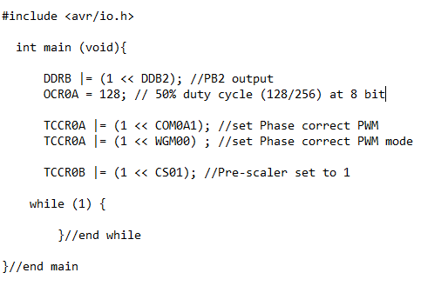
Motor Controller and μController
DDRB sets pin output (PB2)
OCR0A is 8 bit register used for PWM duty cycle
TCCR0A is used to determine what PWM used (fast, phase correct, or counter), and if upcounting or downcounting
TCCR0B is used as prescaler factor

Slide 9
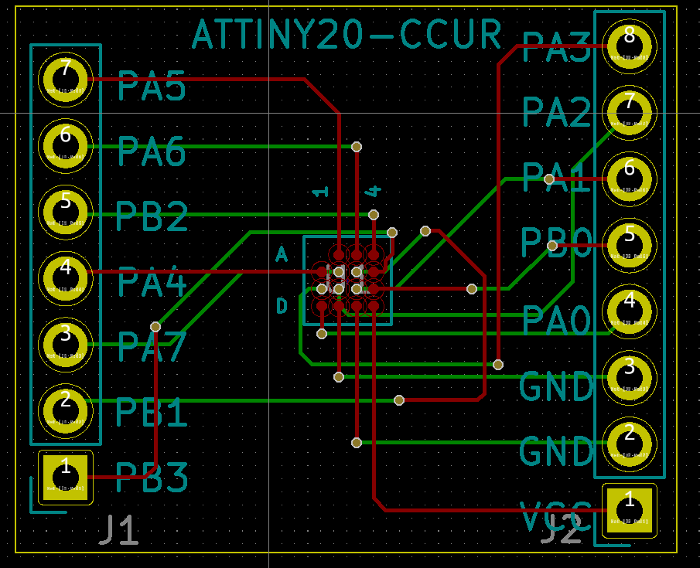
Motor Controller and μController
This is the PCB design for ATTINY20-CCUR.
Created using KiCad, which would be used for initial attempt at creating connection between ATTINY20 and PICkit.
Though various attempts were made, connection was not successful and instead had ATTINY20-MMHR replace this microcontroller.

Slide 10
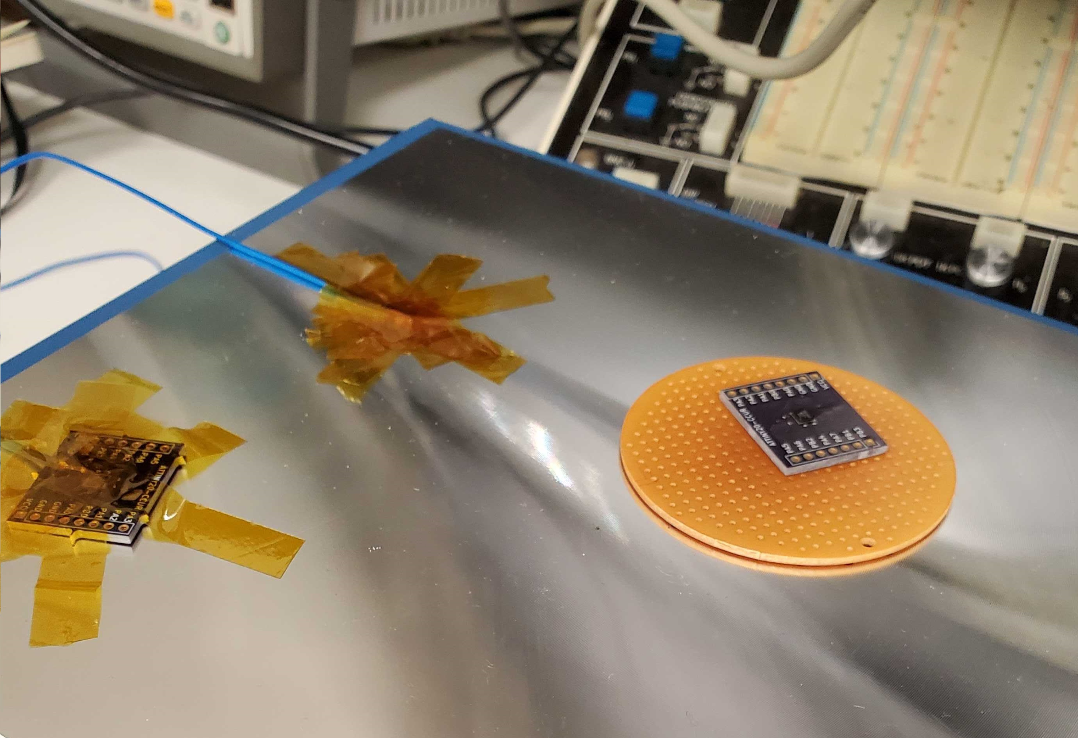
Motor Controller and μController
ATTINY20-CCUR soldering process
This package was a UFBGA, and was soldered onto fabricated PCB using flux and a hot plate
Unsuccessful connection, so soldered the ATTINY20-MMHR and created successful connection

Slide 11
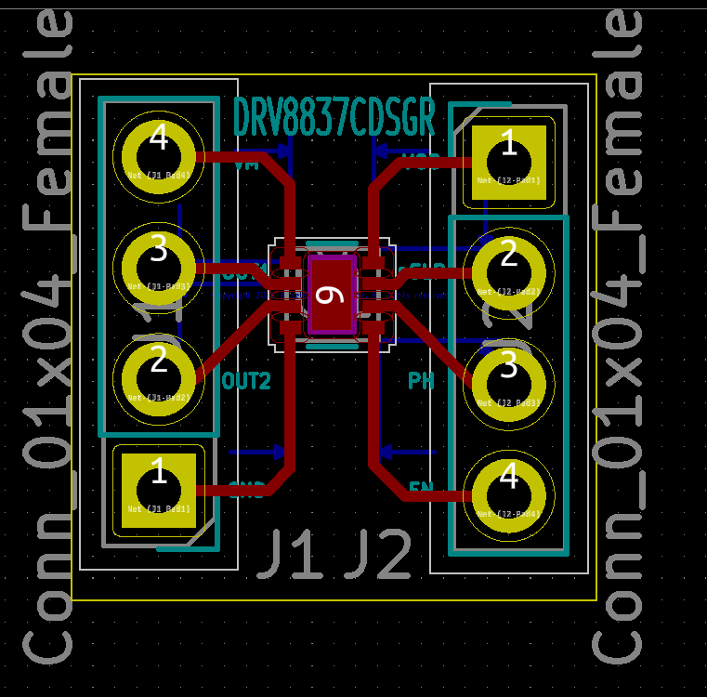
Motor Controller and μController
PCB design for the H-Bridge driver for our first motor test.
Designed using KiCad, in order to test the motor and PWM waves.
Initial test with ATTINY24A and motor controller proved successful, with video demonstrating implementation

Slide 12
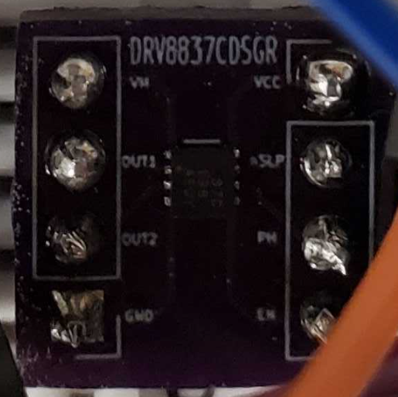
Motor Controller and μController
The designed PCB, containing the soldered H-Bridge Driver motor controller.
Motor controller was soldered onto PCB using solder paste and a hot plate
The fabricated PCB then had pins soldered onto it, in order to test on breadboard

Slide 13
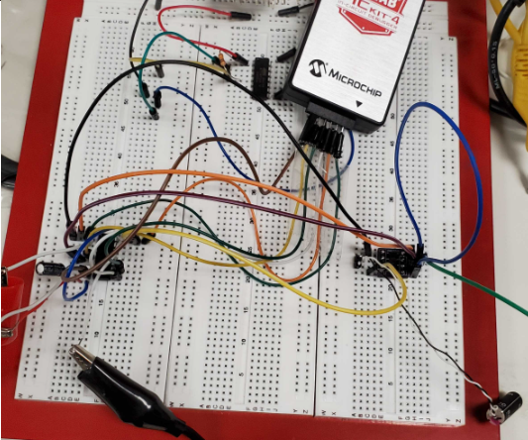
Motor Controller and μController
First test with chosen motor controller & its fabricated PCB, along with connections from ATTINY24A for PWM
Successful connections were established and demonstration of working motor controller/motor can be seen in following slide

Slide 14
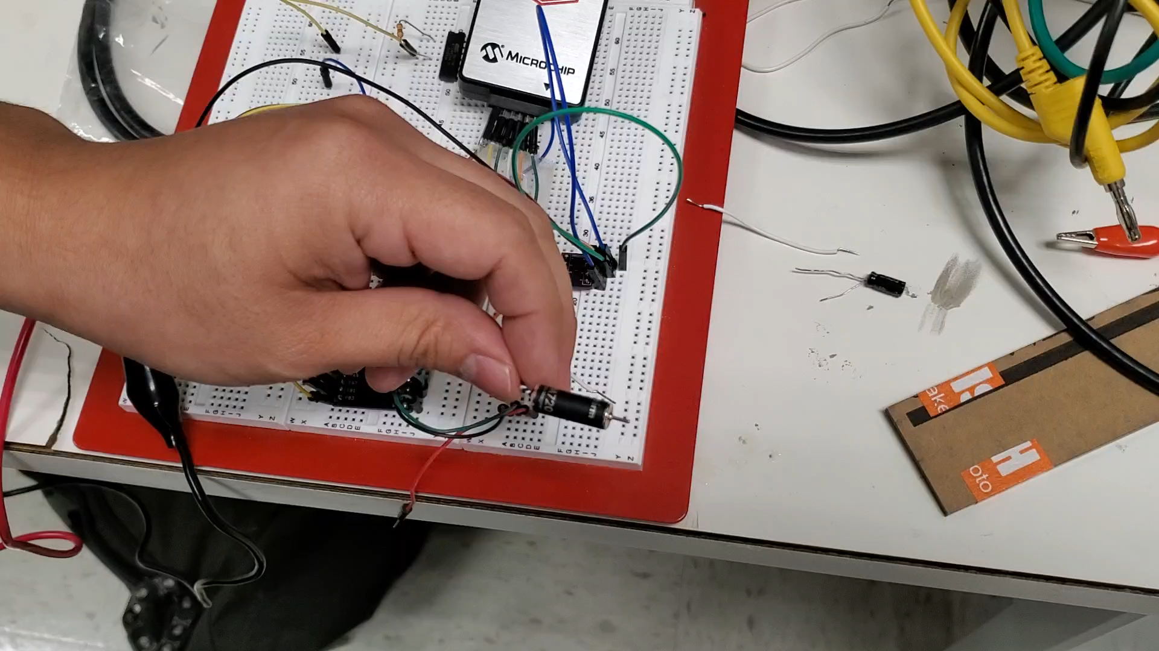
Motor Controller and μController
Working motor controller using the ATTINY24A
This would be done in order to confirm that future connections between ATTINY20 and PICkit would remain the same as with ATTINY24A, along with the implemented C code.
[5]

Slide 15
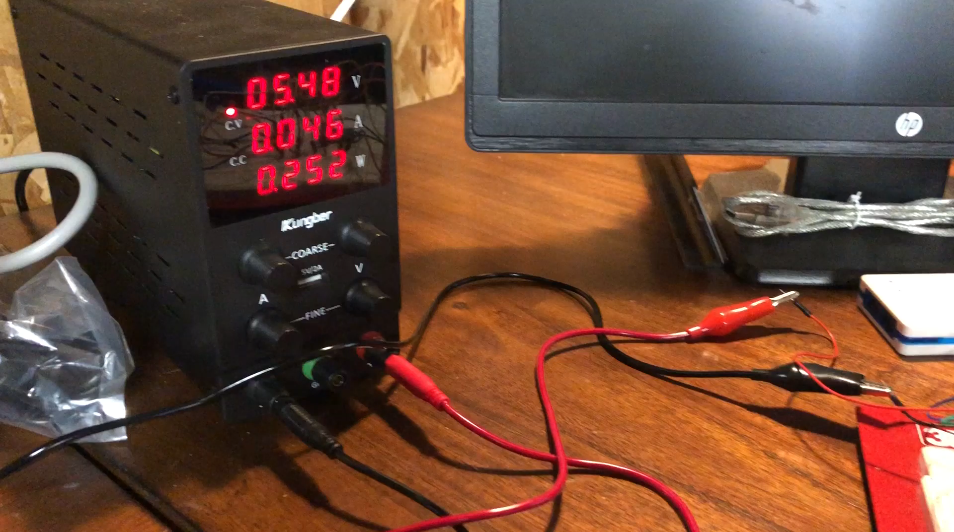
Motor Controller and μController
ATTINY20-MMHR connection after ATTINY20-CCUR was not able to produce proper connection.
Video demonstrates fabricated PCB for ATTINY20-MMHR, and successful programming for PWM wave output
[6]
Notes:
Google drive link: https://drive.google.com/file/d/1y8OUHFcmrJXs1CcQBEaeqDlyr4NGHoDP/view?usp=sharing

Slide 16
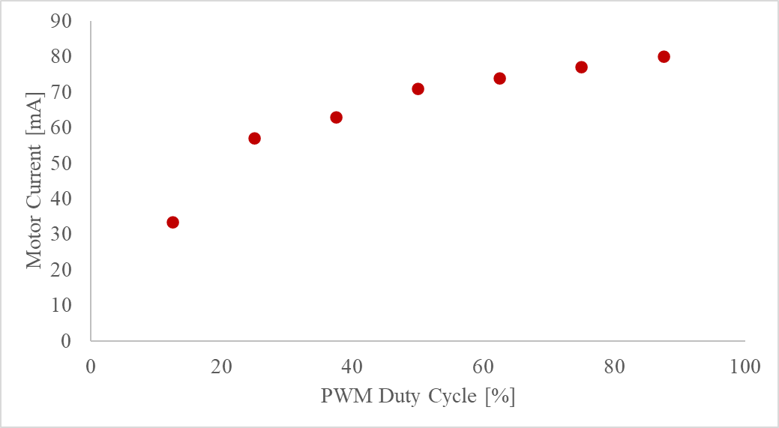
Motor Controller and μController
Plot taken of various duty cycle percentages, to demonstrate correlation between duty cycle and motor current
This graph demonstrates that as PWM Duty Cycle increases, motor current increases.

Slide 18
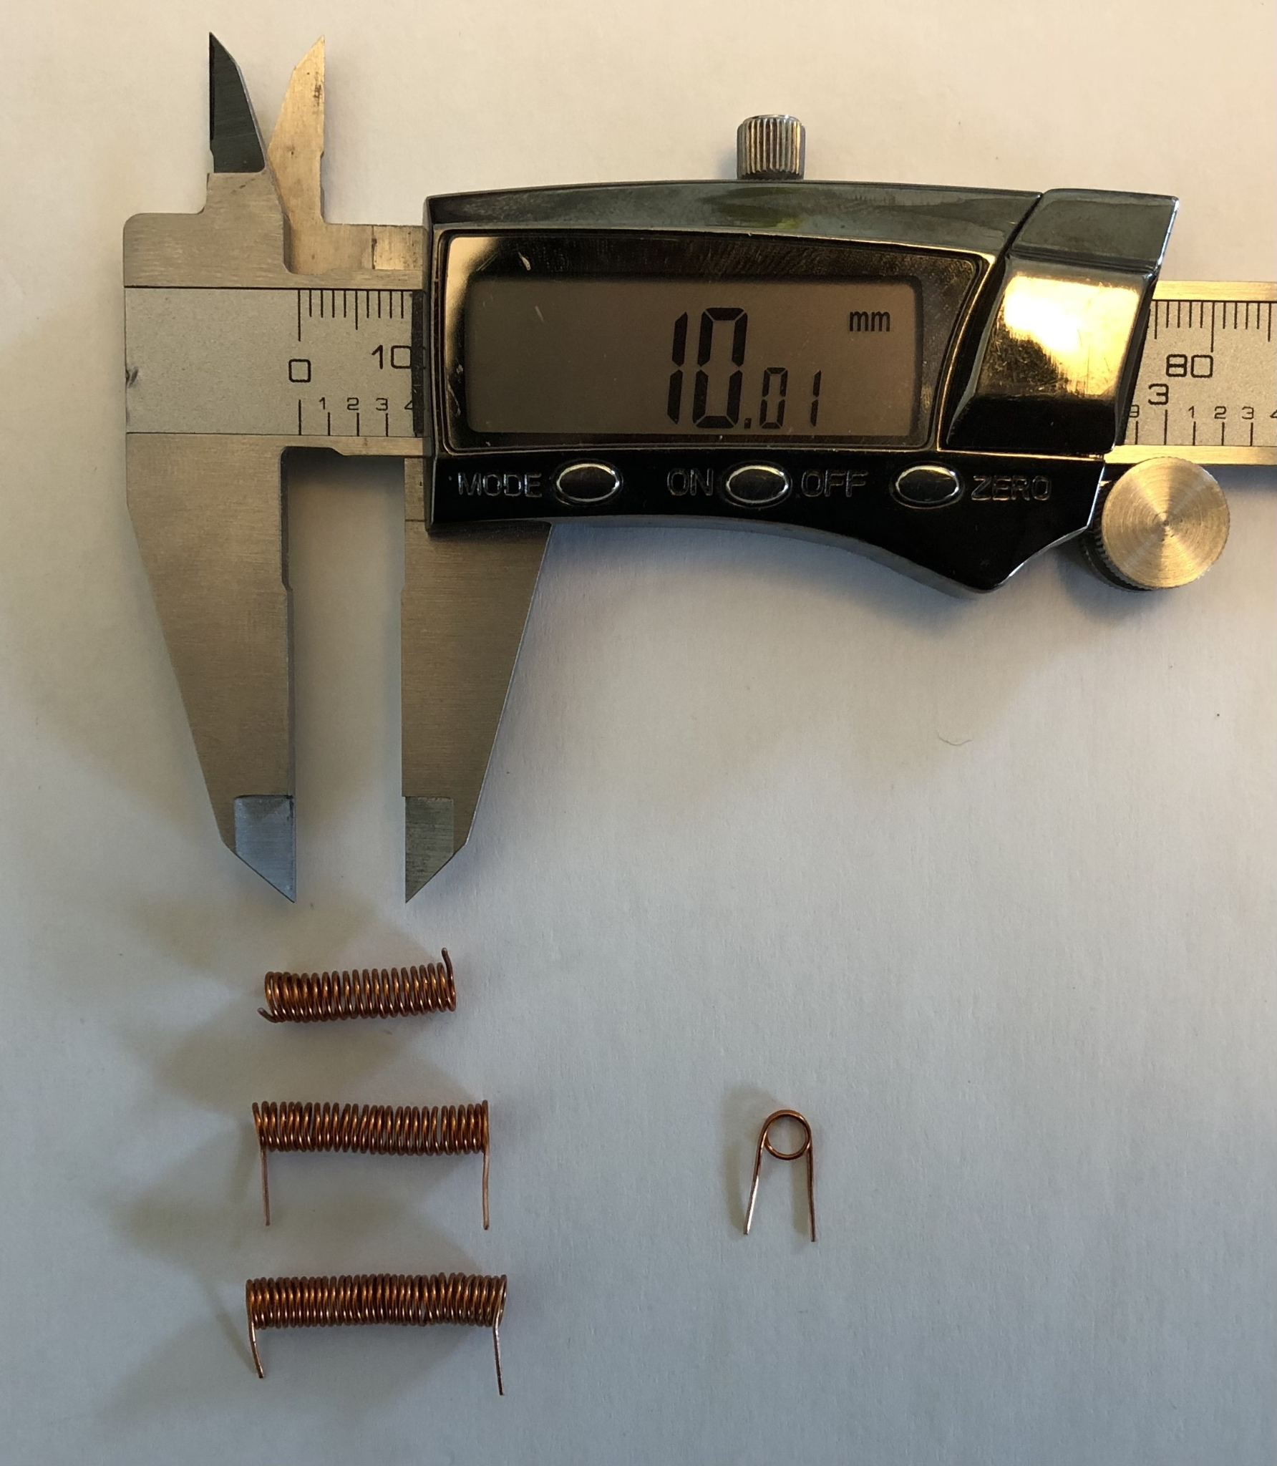
Internal Resonator
To create the resonator, a copper wire was used to make multiple solenoid inductors.
The solenoid inductors had 20, 25, and 30 turns and were all a length of three inches.
The inductance of each was 380.8, 595.0, and 856.8 nH.

Slide 19
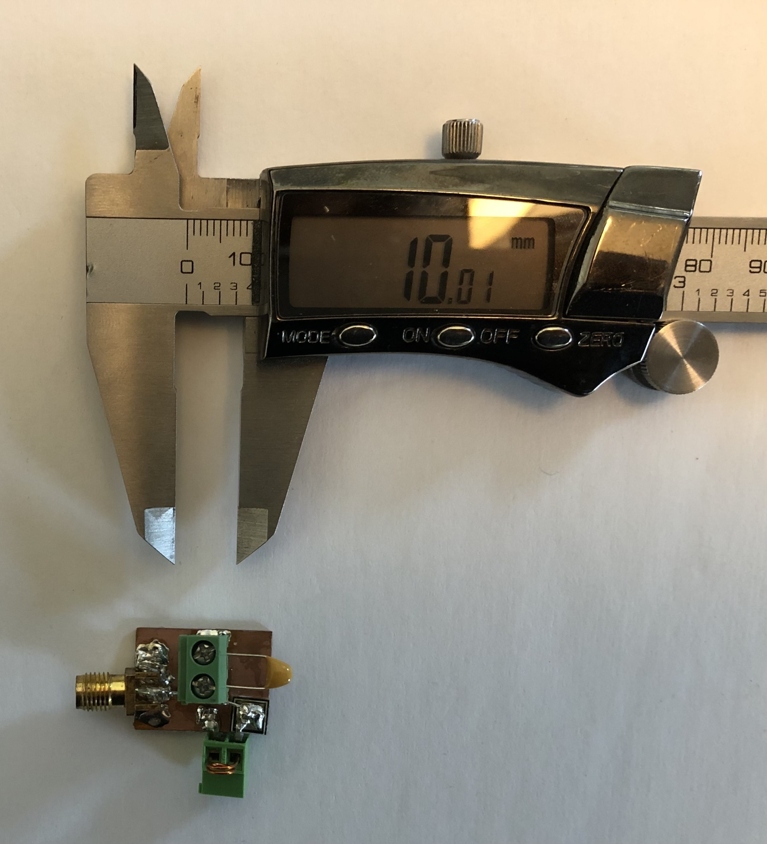
Internal Resonator
To quantify coupling and efficiency of the internal resonator and receiver, a jig was created.
The jig contained an SMA connector and two ports to connect to the resonator and tuning capacitor.

Slide 20
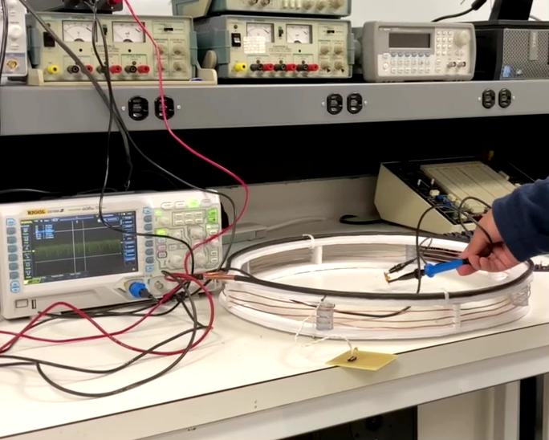
Coupling our resonator with a transmitter.
[7]

Slide 21
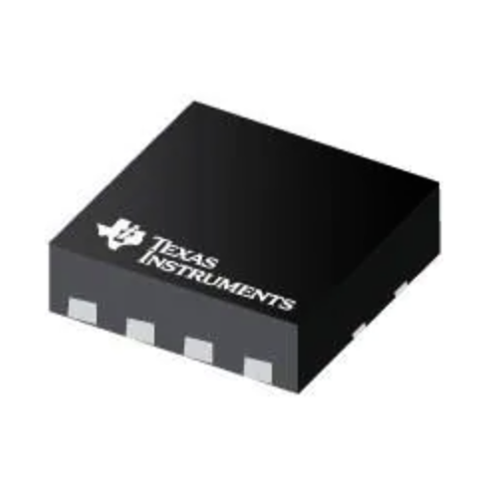
Power Distribution
Voltage Regulator: TLV76760QWDRBRQ1
3.1 mm x 3.1 mm area
Micro Controller: ATTiny20
The quiescent current draw for the is 0.2 mA in active mode
Motor Driver: DRV8837
current draw is 0.04-0.1 mA for the motor controller in operation
The motor for our project needs 6V with maximum current draw from the motor being 800mA
[4] Voltage Regulator

Slide 23
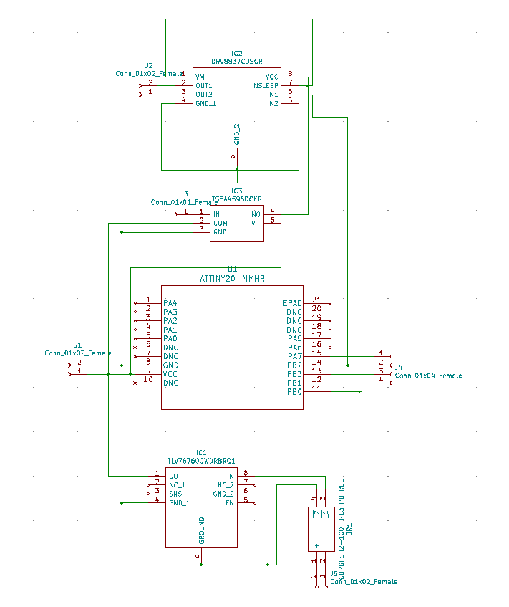
Finalized PCB
This is the schematic for our PCB.
Bridge rectifier (CBRDFSH2-100)
Voltage Regulator (TLV767-Q1 1-A, 16-V)
Microcontroller (ATTiny20-MMHR)
Voltage Switch (TS5A4596 8-Ω SPST analog switch)
Motor Driver (DRV8837)

Slide 24
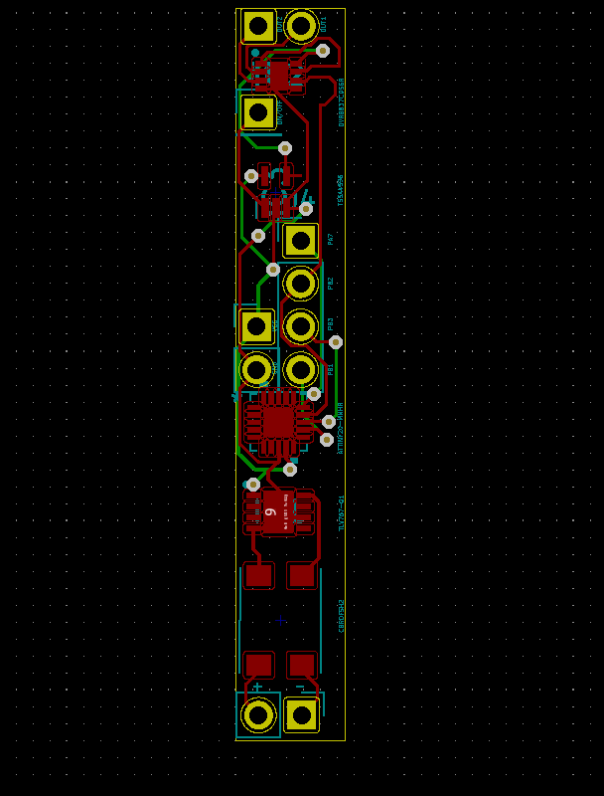
Finalized PCB
Dimensions of board:
Width: 6.5 mm
Length: 43.25 mm
Challenges:
Fitting width-wise.

Slide 25
Conclusion
Design a functioning motor controller that will fit within the left ventricle.
It must be at maximum 8 mm in width and a 76 mm height.
The speed of the motor must be adjustable.
Initiate the design of a wireless receiver
✔
✔
✔
✔

Slide 26
References
[1] Singhvi, Aditi, and Barry Trachtenberg. 2019. "Left Ventricular Assist Devices 101: Shared Care for General Cardiologists and Primary Care" Journal of Clinical Medicine 8, no. 10: 1720. https://doi.org/10.3390/jcm8101720
[2]“ATTINY24A/44A/84A - Microchip Technology.” [Online]. Available: https://ww1.microchip.com/downloads/en/DeviceDoc/ATtiny24A-44A-84ADataSheet-DS40002269A.pdf. [Accessed: 2021].
[3] “Developer help” MPLAB® PICkit™ 4 Debugger Pinouts for Interfaces - Developer Help. [Online]. Available: https://microchipdeveloper.com/pickit4:interface-pinouts. [Accessed: 2021].
[4] “TLV76760QWDRBRQ1 Texas Instruments - Mouser" [Online]. https://www.mouser.com/ProductDetail/Texas-Instruments/TLV76760QWDRBRQ1?qs=CiayqK2gdcKQRB%2FtjN%252BNqw%3D%3D. [Accessed: 2022].
[5] https://drive.google.com/file/d/1LE2jHrDOPmMQgaHGtjfH25HMzOFVebrk/view?usp=sharing
[6] https://drive.google.com/file/d/1y8OUHFcmrJXs1CcQBEaeqDlyr4NGHoDP/view?usp=sharing
[7] https://drive.google.com/file/d/1Y4xjb_yuiybMhfpvFjTYyW15OyTK1V4L/view?usp=sharing

